Slide 1
Coop101 – Week 3
Market Your Skills II
Brittany Root, M.Ed, PHR
Assistant Teaching Professor
Steinbright Career Development Center
Pronouns: she/her/hers
bhr26@drexel.edu

Slide 2
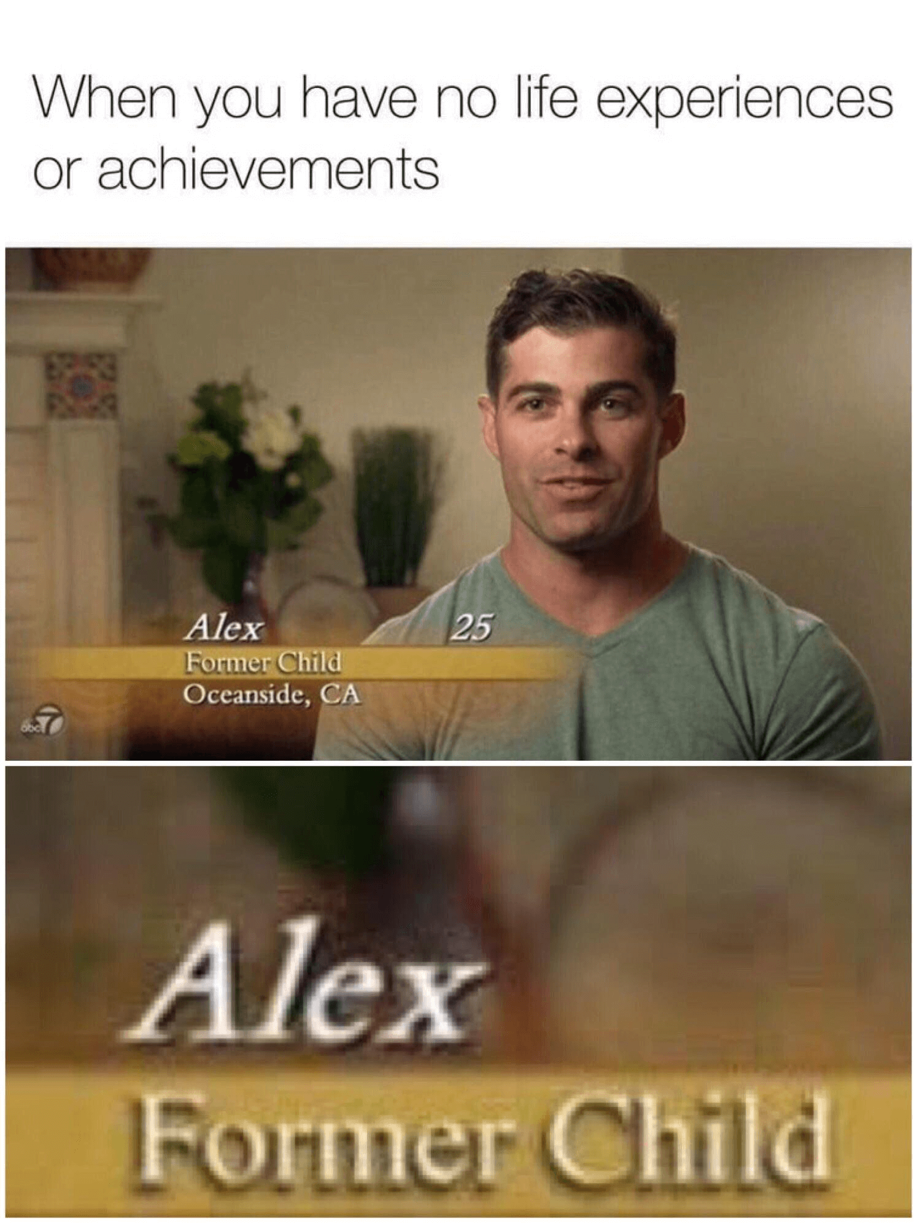
Today’s Agenda:
Workplace Tip
Interview Question
Resume Part Two
To Do Before Next Week

Slide 3
Interview Question:
Where do you see yourself in five years?
Notes:
Key pitfall to avoid is alienating the employer you are interviewing with by describing work not in alignment with co-op you are pursuing
Important to be as intentional as possible!

Slide 4
Discuss:
Rate these responses on a scale of 1 to 5, and if there are concerns, what are they?
(show the interest in continuing working in the industry/company)
Can be general
“Throughout my undergraduate degree I plan to develop a business plan for a start-up company I will launch within 6 months of graduation”.
“My ultimate goal is to become a published author, and I plan to spend the first year after graduation writing full-time and connecting with potential publishers”.

Slide 5

Workplace Tip: Make connections with colleagues and those in your field
Notes:
10 tips for finding a mentor: https://www.themuse.com/advice/how-to-find-a-mentor
Challenging to build workplace connections with remote work-Must be Intentional
LinkedIn, Handshake, Dragon Network are resources we will cover in week 9 for networking within your industry to build connection

Slide 6
Building Connections in the Workplace
Ask Questions Strategically
Make opportunities for “small talk”
Schedule time with people
Use the “chat platforms” offered by employer
Employee gathering areas
Join small talks, say yes to gathering invitations,
Longer Term:
Identify a Mentor
10 tips for finding a mentor: https://www.themuse.com/advice/how-to-find-a-mentor
Reverse Mentorship
Build Industry Connections (LinkedIn, Handshake, Dragon Network)

Slide 7

Resume Experience Section
Everyone Has Experience
Projects (creative majors, BUSN, ENGR)
Work (PT, work study, summer, internship
Volunteer (extended period of time, relevant)
Military
Activities/Organization
Leadership
Notes:
Carefully review the experience section entry options above. You will need to have at least 2 experience entries, with 3 as the goal, so using experience other than paid part-time jobs may be necessary. Project experience is a common additional entry, but you can also consider longer term volunteer roles and leadership within an organization.

Slide 8
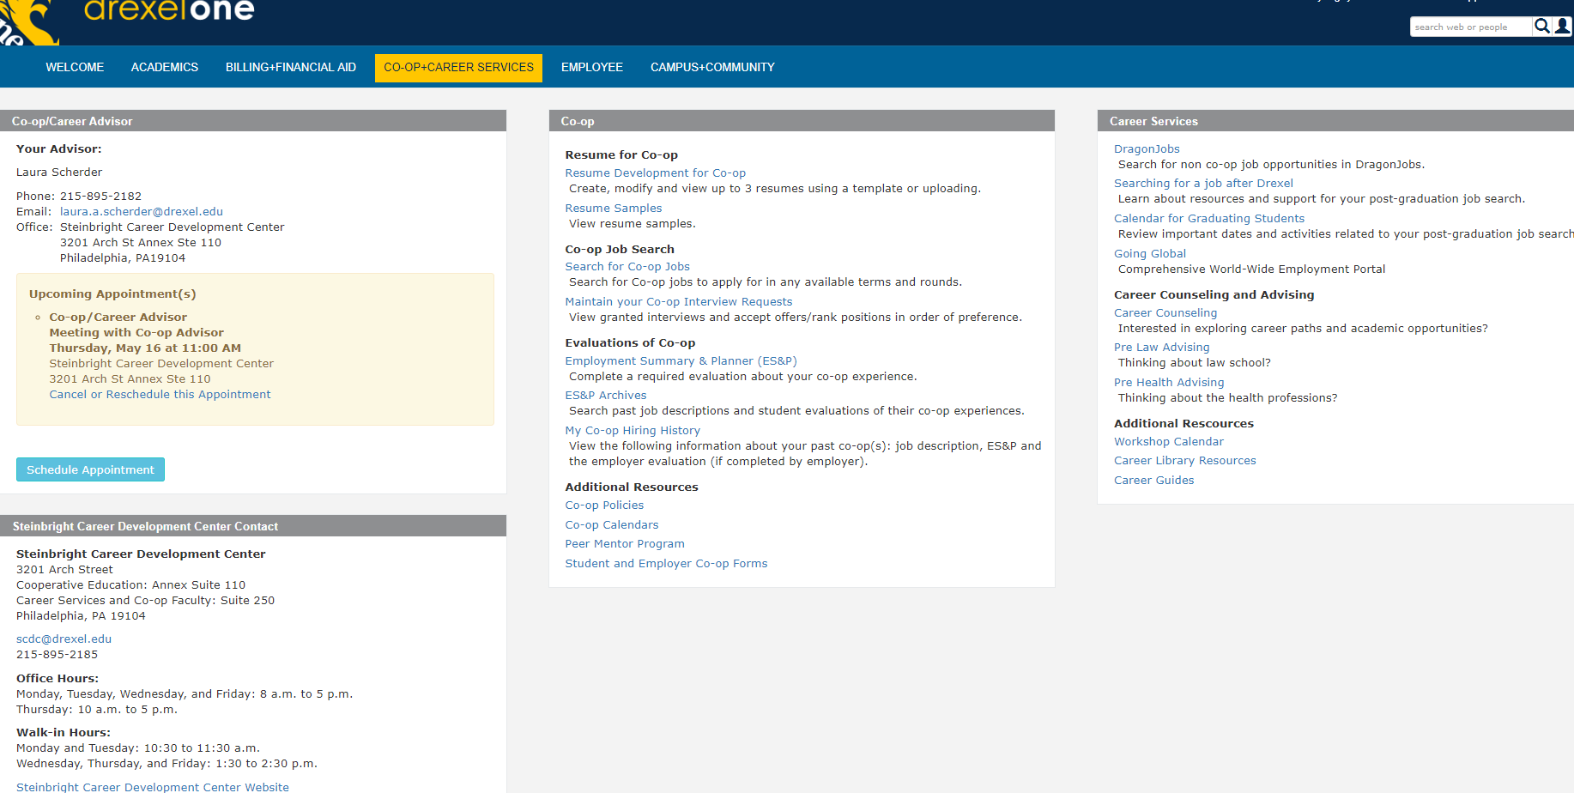
It’s An Open Book Test!
Notes:
The ES&P Archive through Drexel One will allow you to get a feel for companies and positions that Drexel students have experience with.
While Co-op may seem far off, it is important to start to think about what type of companies and what type of positions you may want to apply to and for. As long as you have access to Coop & Career services tab in DrexelOne you can access an archive of positions that student shave held during the past 6+ years. The next four slides walk you through gaining access to the archive.
You should start to review job descriptions here to start getting a sense of the types of duties and responsibilities you will be required to perform while on coop. You can also see some of the companies who have hired Drexel students and their locations. It is important to start getting a sense of where your industry is going (both physically and skill based). Once you identify trends in skills companies are looking for you can better build your resume to include these skills.

Slide 9
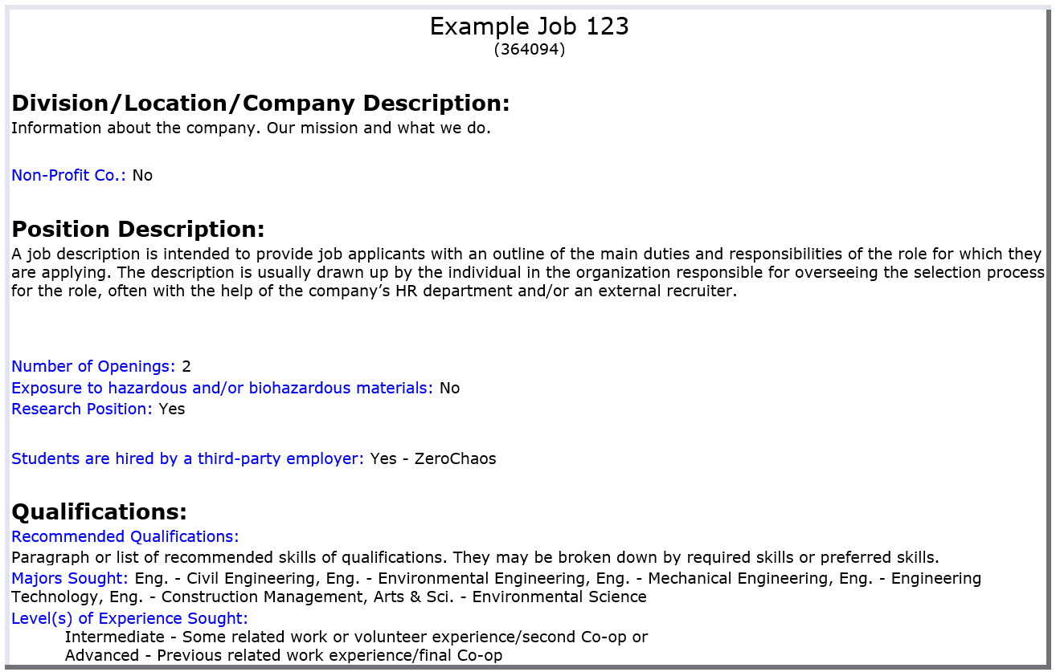
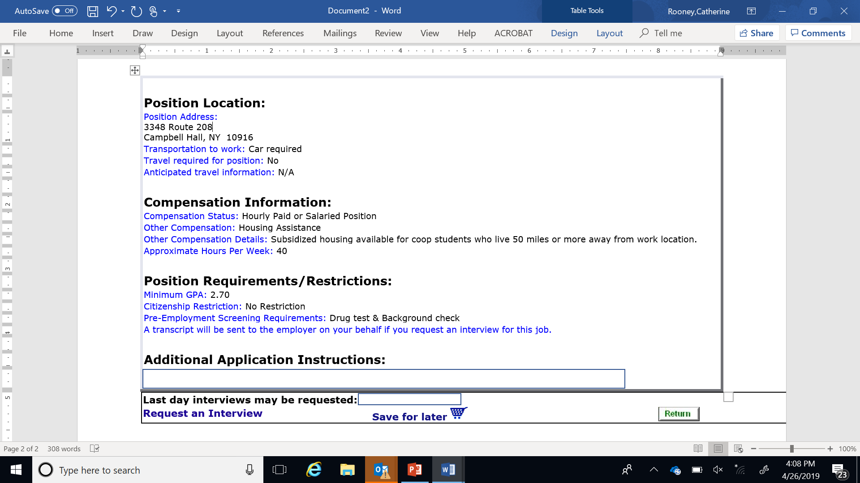
JOB DESCRIPTION SCREEN
Notes:
This is an example of a job description. They are all formatted the same way, the data base is built by the employers. Carefully read and look for the recommended qualifications the employer is seeking in a candidate. For example if the employer states that knowledge of Microsoft Excel is a must and you do not have much experience with it, you should rethink applying for this position or be thinking about how you can get Excel certified before your resume goes out. What are the positions responsibilities? Note the location of the job and determine what your commute will be.

Slide 10
Experience Section Formatting
Use 1 Column bulleted option ONLY – stretch description across the page with detail (qualify & quantify)
Use concise phrases, NOT full sentences
No punctuation at end of lines
Employment Experience
Name of Employer Philadelphia, PA
Role March 2020 to Present
Accomplishment statement 1
Accomplishment statement 2
Accomplishment statement 3
Project Experience
Give the Project a name Philadelphia, PA
Give yourself a role within the project March 2020 to Present
What was the purpose of the project? Describe what you created?
Technical skill describing action you specifically took
Another specific aspect you worked on and/or a statement of result
Notes:
An experience entry should have all of the following: Name of the Organization or Name of project; a role within the organization or project, location (city, state), date (month, year), bullet points describing experience and skills gained in Verb, task, context, result format)

Slide 11
Bullet Points Should Be Accomplishment Statements!!
Verb
Task
Context
Results
Start with strong action verb
What was the task you completed?
Why was this important?
Who did you complete the task for?
How was the information used?
Time frame
Number of people
Quantify
Did you:
Save time
Increase productivity
Reduce costs
Improve a procedure
Increase sales
Enhance performance
Create a new procedure now used
Notes:
Bullet points should start with a strong action verb, no “I statements”, All of the components listed on this slide should be included in each bullet point description with the exception of a statement of result which sometimes won’t be possible.
Your bullet point should read like an accomplishment statement versus describing the basic functions of the job you did. You should highlight transferrable skills. An example would be that instead of saying you washed the dishes, describe working in a fast paced, high volume setting under tight time constraints as those are the transferrable skills you would need to develop to be successful as a dishwasher.

Slide 12
Accomplishment Statement Example 1
Not Great:
I worked the cash register
Great!
Processed cash and credit transactions up to $500 a day in a fast-paced, high volume retail setting, and was recognized for high customer satisfaction rating
Verb
Task
Context
Results
Processed
Processed cash and credit transactions
$500 a day
Fast paced
High volume
Retail setting
High customer satisfaction rating

Slide 13
Accomplishment Statement Example 2
Not Great:
Responsible for forecasting 2018 tax liability for clients
Great!
Forecasted 2018 tax liability for up to 50 clients to develop tax planning strategies and on-time tax payments adhering to IRS rules and regulations resulting in an average of 15% savings per client
Verb
Task
Context
Results
Forecasted
Forecasted 2018 tax liability
For up to 50 clients
To develop tax planning strategies & on-time tax payments
Adhering to IRS rules & regulations
Resulting in an average of 15% savings per client

Slide 14
Accomplishment Statement Example 3
Not Great:
Responsible for reviewing metrics reporting process
Great!
Automated and refined monthly metrics reporting process utilizing advanced Excel functionality such as PivotTables and VLOOKUP, saving the company $10K annually
Verb
Task
Context
Results
Automated &
Refined
Monthly metrics reporting process
Utilizing advanced Excel functionality such as Pivot Tables & VLookUP
Saving company $10K annually

Slide 15
Project Experience
Academic Business Project
Mike’s Bikes Philadelphia, PA
Chief Executive Officer September – December 2020
Managed team of four to develop business plan, researched market trends
Created marketing materials to increase profit
Analyzed results to grow virtual business by 32% over 3 months
Engineering Design Project
Gymnasium Renovation Project Philadelphia, PA
Co-Developer September – November 2020
Developed plans to renovate an abandoned building into a gymnasium
Created 3 design plans using AutoCAD, built 3D models
Consulted with professionals on procedures and methods
Compiled 40 page report which consisted of detailed drawings, proposals, gnatt charts
Notes:
Project experience can be a great way to show relevance to your specific field, and to highlight relevant technical skills you may not have used in your PT work experience. Bullet points should still begin with a strong action verb, state the task, and provide some context and result.
Follow the same format as you would for a work experience!

Slide 16

Verb Tense
If you had a job in the past, use past tense
Assisted customers with pricing information in busy high-end boutique
If you have a job now, use present tense
Assist customers with pricing information in busy high-end boutique
*** No “Ing” or “S” at the end of your verbs***
Notes:
Don’t use “ING” tense or “S” present verbs

Slide 17
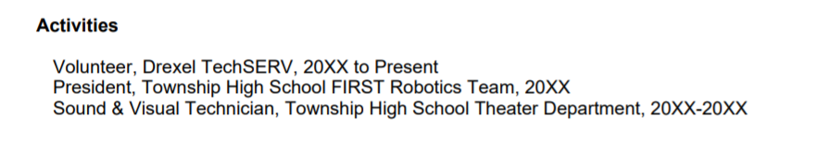
Activities Section
DragonLink
Well-Rounded
Relevant
Leadership
Personal projects
Role, Name of Org, Dates
OK to include information from high school
Notes:
Chance for you to show you are well-rounded, can include sports, musical instrument, possibly hobbies. Activities for which you were in a leadership experience could be listed here as a one line entry or in the experience section with bullet points.

Slide 20
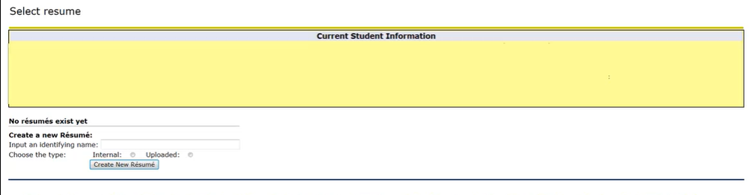
Resume Upload/Saving
If you create in the system, resume is already saved, but ensure your most recent version is set as default!
If uploading outside template, System will only take .pdf format
Visit Drexel One---Click on Co-op and Career Tab---Resume Development Link—Enter file Name—Upload on next screen
Notes:
If you want to work with a resume template you have developed previously, you can upload a .pdf of that file to the system. Choose the “uploaded” radial button on the “create a new resume” screen and the next screen will allow you to browse your computer to find the file.

Slide 21
Pull up your resume draft and revise or add the content sections we discussed today.
In-Class Work

Slide 22
Section Checklist:
Name, Contact Information
Education
Honors/Awards
Experience – 3 (minimum) Experiences, each annotated with 3 (minimum) bullet point annotations
Skills
Activities – 2 (minimum), preferably something at Present
Relevant Coursework
DUE: Before Next Week (Week 4) (by start of class)!
Complete resume (30 points)
Click “View Resume” on the template so you can see what it looks like to me (and employers).
No need to email it to me or “submit it”.
I will download it from SCDC online for grading.

